Slide 1
MEDB 5510 Clinical Research Methods
Week 12
Data Analysis & Interpretation

Slide 2
Making Inferences - NHST
Populations versus Samples
Use inferential statistics
Sample statistics (M, SD) ➔
Population parameters (mu, sigma)
Null Hypothesis Significance Testing (NHST)
Null hypothesis (H₀)
Alternative hypothesis (H₁)
AKA research hypothesis
Directional
Non-directional
2

Slide 3
Making Inferences - NHST
NHST – Goal of research –
Reject the H₀ in favor of H₁
“Reject” the null hypothesis
Practically – “reject” means difference / relationship greater than just random variability
Alternative hypothesis –
3 versions
Non-directional
Directional positive
Directional negative
3

Slide 4
Making Inferences - NHST
Directional vs Non-directional H₁
Comparing treatment to control
Comparing different treatments
Choosing directional vs non-directional
Basis for choice
Consequences
Statistical analysis
Interpretation
4

Slide 5
Making Inferences - NHST
Sampling review
Target / theoretical population
Accessible population
Sample
Inference from the study sample to the population
5

Slide 6
Making Inferences - NHST
Example
6

Slide 7
Making Inferences - NHST
Accessible population ➔ Sample
Random assignment to groups
Conduct study and collect data
Conduct statistical analysis
Intervention group: mean = 73
Control group: mean = 65
7

Slide 8
Making Inferences - NHST
Significant difference or not?
Inferential statistics – allow you to determine this
Reject the null ➔
The observed difference is highly unlikely if the null hypothesis is actually true
Fail to reject the null ➔
We can not say that the observed difference is highly unlikely
Do NOT “accept” the null hypothesis
8

Slide 9
Making Inferences - NHST
Statistical testing – possible outcomes
 | TRUTH
DECISION | H_{o} is true (there is no relationship) | H_{o} is false (there is a relationship)
Reject H_{o} (you find a relationship) | Type I Error Alpha | Correct (Decision agrees with Truth) Power
Do not reject H_{o} (you do NOT find a relationship) | Correct (Decision agrees with Truth) | Type II Error Beta (Power = 1 - Beta)
(Portney & Watkins, 2009)

Slide 10
Making Inferences - NHST
Statistical testing – possible outcomes

Slide 11
Making Inferences - NHST
Statistical testing – possible outcomes

Slide 12
Making Inferences - NHST
Statistical testing
Fig 16.3 – Directional negative
Example – hypothesize that intervention will result in reduction of symptoms
If you made a directional positive alternative hypothesis …. ?

Slide 13
Making Inferences - NHST
Statistical testing
Fig 16.4 – Non-directional

Slide 14
Power Analysis
Probability of rejecting a false H₀
This is a GOOD thing!
Want to maximize this (within reasonable limits!)
What is power analysis
“… the probability that his investigation would lead to statistically significant results.”

Slide 15
Power Analysis
Power of a study
 | TRUTH
DECISION | H_{o} is true (there is no relationship) | H_{o} is false (there is a relationship)
Reject H_{o} (you find a relationship) | Type I Error Alpha | Correct (Decision agrees with Truth) Power
Do not reject H_{o} (you do NOT find a relationship) | Correct (Decision agrees with Truth) | Type II Error Beta (Power = 1 - Beta)
(Portney & Watkins, 2009)

Slide 16
Power Analysis
Power of a study – probability of rejecting a false null hypothesis

Slide 17
Power Analysis
Statistical power analysis concepts (Cohen)
Significance criterion – alpha
Power – desired level
Sample size
Effect size
Power analysis method depends on research design

Slide 18
Power Analysis
Performing a power analysis when planning a study
What is the study design?
What do you already know about the measure you are interested in?
What significance level to you want to use for hypothesis testing?
What level of power do you want to achieve?

Slide 19
Power Analysis
Determining power (Fig 16.1)

Slide 21
Power Analysis
Increasing power –
Alpha level
Formulation of hypothesis
Decrease variability / increase precision
Groups
Outcome measure(s)
Increase sample size

Slide 22
Power Analysis

Slide 23
Power Analysis

Slide 24
Problems with NHST
Knowledge based on outcome of single study
Interpretation of statistical significance
Complications
H₀ is rarely true – in a strict sense
Too large of a sample size – hard NOT to get statistical significance
Significance testing as a dichotomous decision
Interpretation of changes in the p value
Statistical significant versus clinical/substative meaningfulness

Slide 25
Improving NHST
Propose specific alternative hypotheses
Use a random sample if possible
Use an outcome variable that has good reliability and validity
Have a good idea of the level of difference that will be clinically important

Slide 26
Making Inferences - EBA
EBA – Evidence-Based Approach
Reliability of findings
Accumulation of evidence
Premise – “… a single study is not sufficient to use as evidence to substantiate a hypothesis or theory.”
Methods
Confidence intervals
Effect sizes
Meta-analysis

Slide 27
Making Inferences - EBA
Confidence Intervals (CI)
Range of scores that should contain the true population score
CI ➔ An interval around the point estimate
CI ➔ “… range of the dependent variable scores that should contain the true population difference between means.”
CI computed using sample mean and standard deviation

Slide 28
Making Inferences - EBA
Interpretation of CI –
95% CI most common
95% CI – with infinite studies and computed CI, the true population difference would be found within 95% of the intervals
NOT – .95 probability that true population difference is within the CI computed from our single study
Option – 95% CI for a given study “… estimates the population mean difference with 95% confidence.”

Slide 29
Making Inferences - EBA
Why compute and report CI?
Part of philosophy to encourage replication
Size of interval – “… how much of the estimate might be due to sampling error.”

Slide 30
Making Inferences - EBA
Interpreting 95% CI (Fig 17.1)

Slide 31
Making Inferences – EBA
Effect size –
Strength of relationship between IV & DV
Magnitude of the difference between levels of the IV with respect to the DV
3 types of effect size measures
r family
d family
Measures of risk potency

Slide 32
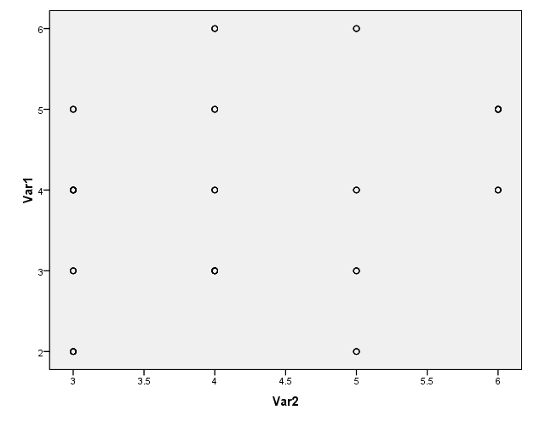
Making Inferences – EBA
Why is effect size at least as important as significance level?
Influence of sample size on results

Slide 33
Making Inferences – EBA
Effect sizes –
Unstandardized – in the units of the raw DV
Standardized –
Standardized using pooled standard deviation of the groups
Measure that can be used to compare to other studies with different DVs

Slide 34
Making Inferences – EBA
Types of effect sizes –
R family – strength of association
D family – magnitude of differences
Measures of risk potency – when both IV and DV are dichotomous
Odds ratio
Relative risk
Risk difference

Slide 35
Making Inferences – EBA
R family of effect sizes – association
r² vs r
Cohen’s guidelines
Weak approx +/- .1
Medium approx +/- .3
Strong approx +/- .5
Authors labeling
Less than typical
Typical
Greater than typical
Also rho, phi, eta, R

Slide 36
Making Inferences – EBA
D family of effect sizes – differences
d ➔ Two group comparison
Treatment group mean – Comparison group mean
Divided by pooled standard deviations from both samples
eta² ➔ Multiple group comparison
Statistics packages will compute
Interpret like r² (amount of variance in DV accounted for by IV)

Slide 37
Making Inferences – EBA
Risk family of effect sizes – When both IV and DV are dichotomous
Phi – measure of association / correlation
Clinical / medical research – the risk of clinical outcomes
Relative risk – ratio that compares the risk of an outcome between groups
Risk difference – percentage difference that compares risk of an outcome between groups
Odds ratio – Odds of outcome in control group compared to odds in treatment group

Slide 38
Making Inferences – EBA
Interpretation of effect sizes –

Slide 39
Making Inferences – EBA
Value of effect sizes –
Indicates the strength of a relationship or a difference
Allows you
Combine results from studies with dissimilar outcome measures
Use findings of previous study to plan study with different outcome measure
Online source to perform power analysis –
Sample Power (part of SPSS)
Russell Lenth – U of Iowa

Slide 40
Making Inferences – EBA
Meta-Analysis
Research synthesis of multiple studies
Uses effect size value from each study
Advantage over systematic review – compute a summary statistic that represents overall estimate
Provides evidence of reliability of research finding
Include findings from studies that failed to find statistical significance
Increased external validity

Slide 41
Making Inferences – EBA
Simoni et al., 2006

Slide 42
Making Inferences – EBA
Simoni et al., 2006

Slide 43
Assignment #9
Complete an “outline” of your written proposal. Refer to the “Research Proposal Structure Overview/Structure” document in the Course Content folder on Blackboard. This “outline” should reflect a substantial amount of detail including sub-headings in the literature review section and methods section. Sections that reflect earlier assignments should contain near-complete drafts of the information that is relevant to your proposed project.
Available resource –
Research Proposal Structure Information document
Week by Week / General Information
43

